Slide 1
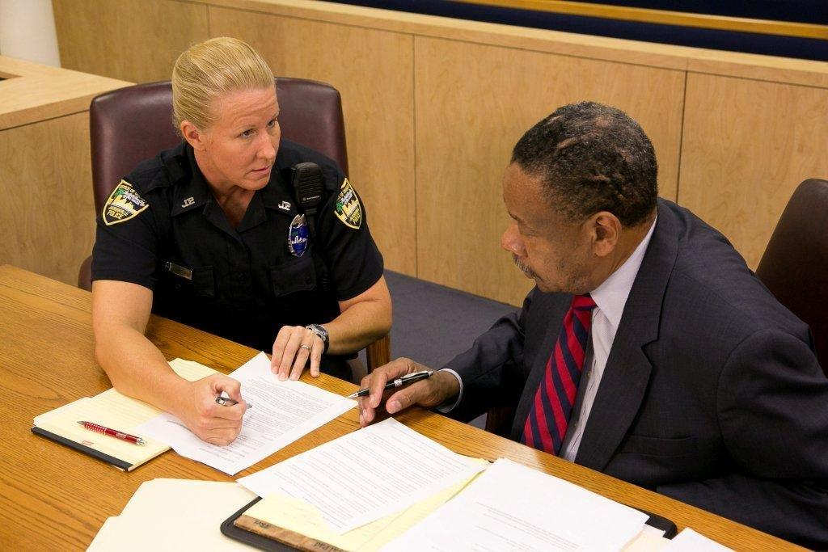



Session 28
Case Preparation
and Testimony

Slide 2
Learning Objectives
  Conduct a thorough pre-trial and prepare for testimony
  Provide clear, accurate, and descriptive direct testimony
  Respond effectively and appropriately to cross examination

Slide 3
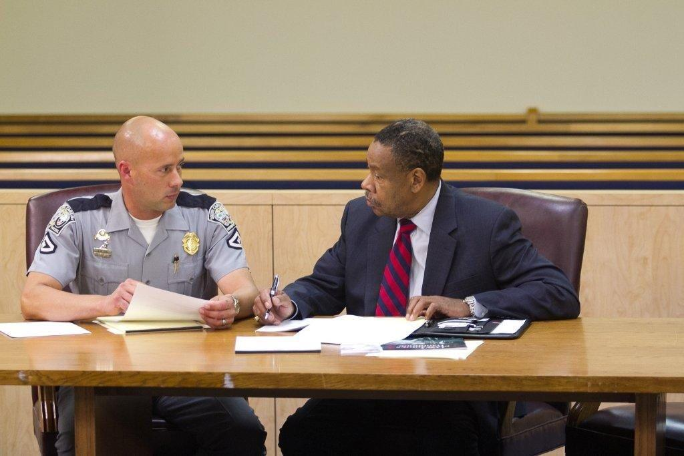
Preparation

Slide 4
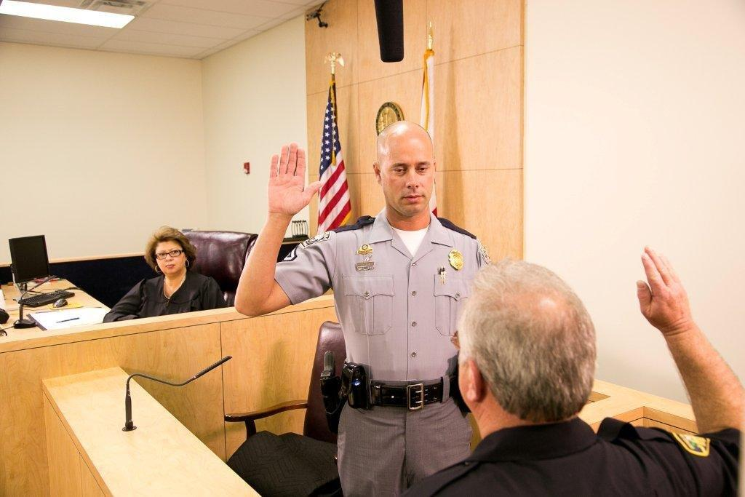
Direct Testimony

Slide 5
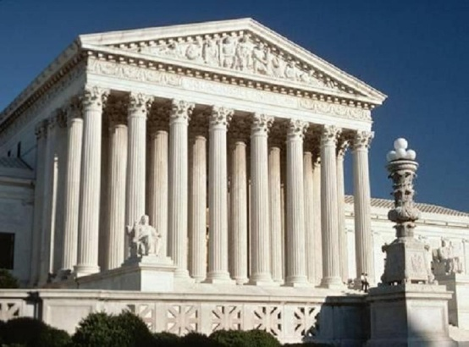
New Scientific Principle
  Most courts employ either Frye or Daubert standards

Slide 6
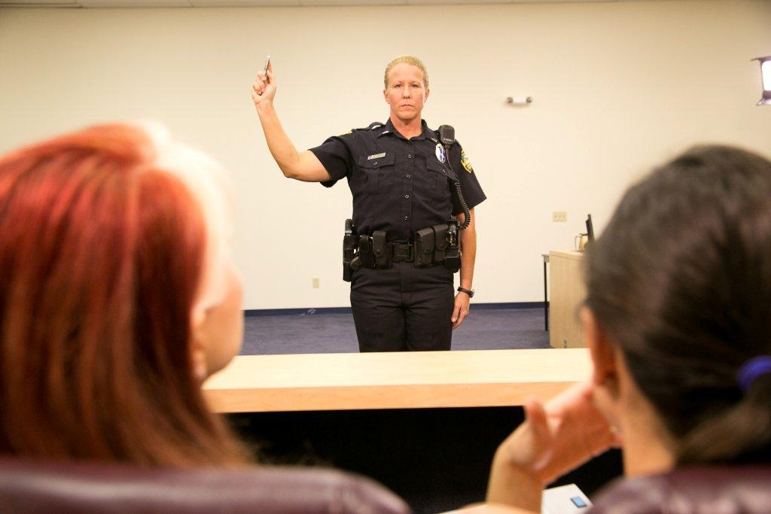
General Guidelines

Slide 7
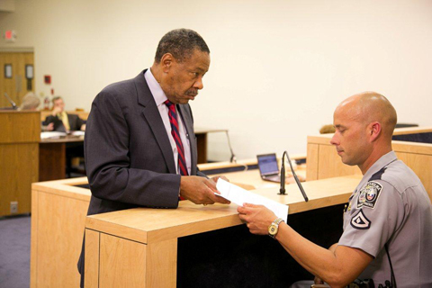
Typical Defense Tactics
  Challenging observations and interpretations
  Challenging credentials

Slide 8
Questions?

